Slide 1
NLP Unit-4

Slide 2
Description Logics (DL)
Definition:
DL is used for structuring and reasoning about knowledge, commonly in AI and semantic web applications.
Real-Life Example:
A medical ontology can classify diseases based on symptoms and treatments.
A smart home system can infer that if a room is occupied and the temperature is low, the heater should turn on.

Slide 3
Demo program
from owlready2 import *
onto = get_ontology("http://example.org/ontology.owl")
with onto:
class Disease(Thing): pass
class Symptom(Thing): pass
class hasSymptom(Disease >> Symptom): pass
covid = Disease("COVID-19")
fever = Symptom("Fever")
covid.hasSymptom.append(fever)
print(list(covid.hasSymptom)) # Output: [Fever]

Slide 4
Description Logics
Description Logics (DL) is a formalism used to represent structured knowledge and reason about it. It is commonly used in ontologies, such as OWL (Web Ontology Language).
Example (Using OWL and RDF
with onto:
class Person(Thing): pass
class hasChild(Person >> Person): pass
# Create individuals
john = Person("John")
jane = Person("Jane")
john.hasChild.append(jane)
onto.save(file="ontology.owl", format="rdfxml")
print(list(john.hasChild)) # Output: [Jane]
from owlready2 import *
# Create ontology
onto = get_ontology("http://example.org/ontology.owl")

Slide 5
Syntax-Driven Semantic Analysis
This technique assigns semantic structure based on syntactic structures, often using context-free grammars (CFGs) and parsing.
import nltk
from nltk import CFG
grammar = CFG.fromstring("""
S -> NP VP
NP -> 'Alice' | 'Bob'
VP -> 'runs' | 'jumps'
""")
parser = nltk.ChartParser(grammar)
sentence = ['Alice', 'runs']
for tree in parser.parse(sentence):
print(tree)

Slide 6
Syntax-Driven Semantic Analysis
Definition:
Assigns meaning to sentences based on their structure.
Real-Life Example:
"John saw Mary with a telescope."
Does John have a telescope, or does Mary?
Syntax analysis helps disambiguate this.

Slide 7
Syntax-Driven Semantic Analysis
import nltk
from nltk import CFG
grammar = CFG.fromstring("""
S -> NP VP
NP -> 'John' | 'Mary' | 'telescope'
VP -> 'saw' NP
""")
parser = nltk.ChartParser(grammar)
sentence = ['John', 'saw', 'Mary']
for tree in parser.parse(sentence):
print(tree)

Slide 8
Semantic Attachments
Definition:
Attaching meaning or functions to grammar rules.
Real-Life Example:
If a sentence contains "buy", it means a financial transaction.
In a chatbot, recognizing "weather" should trigger a weather API call.

Slide 9
Semantic Attachments
from nltk.sem import Expression
read_expr = Expression.fromstring
expr = read_expr('buy(John, Laptop)')
print(expr) # Meaning: John buys a Laptop

Slide 10
3. Semantic Attachments
Semantic attachments add meaning to syntactic structures, often using functions or rules.
from nltk.sem import Expression
read_expr = Expression.fromstring
expr1 = read_expr('runs(Alice)')
expr2 = read_expr('jumps(Bob)')
print(expr1, expr2)

Slide 11
4. Word Senses
Definition:
Words have multiple meanings (polysemy).
Real-Life Example:
"Bank" can mean a financial institution or a riverbank.
"Apple" can mean a fruit or a tech company.

Slide 12
4. Word Senses
Words can have multiple senses, which leads to ambiguity.
https://wordnet.princeton.edu/
https://www.naukri.com/code360/library/wordnet-in-nlp
https://medium.com/@akankshamalhotra24/a-short-note-on-wordnet-aa97a7194ecf
from nltk.corpus import wordnet
synsets = wordnet.synsets("bank")
for syn in synsets:
print(syn, syn.definition())

Slide 13
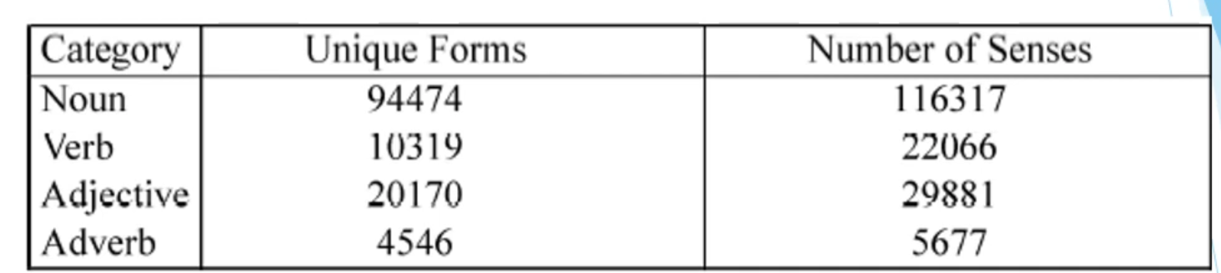
WordNet

Slide 14
Semantic Analysis
The purpose of semantic analysis is to draw exact meaning, or you can say dictionary meaning from the text. The work of semantic analyzer is to check the text for meaningfulness.
We already know that lexical analysis also deals with the meaning of the words, then how is semantic analysis different from lexical analysis? Lexical analysis is based on smaller token but on the other side semantic analysis focuses on larger chunks. That is why semantic analysis can be divided into the following two parts

Slide 15
Semantic Analysis
Studying meaning of individual word
It is the first part of the semantic analysis in which the study of the meaning of individual words is performed. This part is called lexical semantics.
Studying the combination of individual words
In the second part, the individual words will be combined to provide meaning in sentences.
The most important task of semantic analysis is to get the proper meaning of the sentence. For example, analyze the sentence Ram is great. In this sentence, the speaker is talking either about Lord Ram or about a person whose name is Ram. That is why the job, to get the proper meaning of the sentence, of semantic analyzer is important.
Notes:
https://www.tutorialspoint.com/natural_language_processing/natural_language_processing_semantic_analysis.htm

Slide 16
Relations Between Senses
Definition:
Words relate to each other through synonyms, antonyms, hypernyms, and hyponyms.
Real-Life Example:
Synonymy: "Big" and "Large"
Antonymy: "Hot" and "Cold"
Hypernymy (Generalization): "Dog" → "Animal"
Hyponymy (Specialization): "Rose" → "Flower"

Slide 17
5. Relations Between Senses
Synonymy: Similar words
Antonymy: Opposite words
Hypernymy: Generalization
Hyponymy: Specialization
synset = wordnet.synsets("car")[0]
print("Synonyms:", synset.lemma_names())
print("Hypernyms:", synset.hypernyms())
print("Hyponyms:", synset.hyponyms())

Slide 18
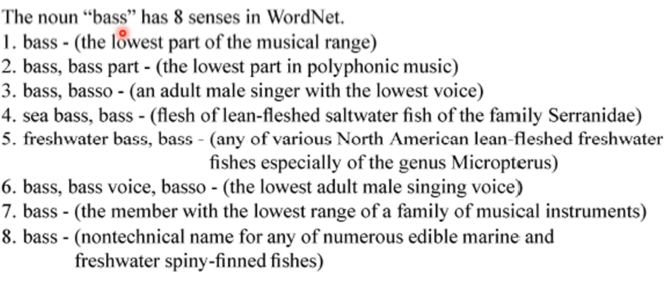

Slide 19
Thematic Roles
Definition:
Assigns roles to words in a sentence:
Agent (doer): "John" in "John eats an apple."
Theme (object affected): "Apple"
Recipient (receiver): "Mary" in "John gave Mary a book."
Real-Life Example:
In Google Voice Assistant, it identifies the agent, action, and object when you say, "Play music on Spotify."

Slide 20
6. Thematic Roles
Thematic roles assign semantic roles to sentence elements (e.g., Agent, Theme).
import spacy
nlp = spacy.load("en_core_web_sm")
sentence = nlp("John gave Mary a book.")
for token in sentence:
print(token.text, token.dep_)

Slide 21
7. Selectional Restrictions
Definition:
Rules that determine which words can logically go together.
Real-Life Example:
"He drank water" ✅
"He drank a rock" ❌ (Incorrect because drinking requires a liquid)
These restrict what arguments a verb can take.
synset = wordnet.synsets("eat")[0]
print(synset.verb_groups()) # Shows related verbs

Slide 22
Word Sense Disambiguation (WSD)
Definition:
Determining the correct sense of a word in context.
Real-Life Example:
"He went to the bank to deposit money." (Bank = Financial)
"He sat by the bank of the river." (Bank = Riverside)

Slide 23
Word Sense Disambiguation
We understand that words have different meanings based on the context of its usage in the sentence. If we talk about human languages, then they are ambiguous too because many words can be interpreted in multiple ways depending upon the context of their occurrence.
Word sense disambiguation, in natural language processing (NLP), may be defined as the ability to determine which meaning of word is activated by the use of word in a particular context. Lexical ambiguity, syntactic or semantic, is one of the very first problem that any NLP system faces.
Part-of-speech (POS) taggers with high level of accuracy can solve Words syntactic ambiguity. On the other hand, the problem of resolving semantic ambiguity is called WSD (word sense disambiguation).
Resolving semantic ambiguity is harder than resolving syntactic ambiguity.

Slide 24
For example
For example, consider the two examples of the distinct sense that exist for the word bass −
I can hear bass sound.
He likes to eat grilled bass.
The occurrence of the word bass clearly denotes the distinct meaning. In first sentence, it means frequency and in second, it means fish. Hence, if it would be disambiguated by WSD then the correct meaning to the above sentences can be assigned as follows −
I can hear bass/frequency sound.
He likes to eat grilled bass/fish.

Slide 25
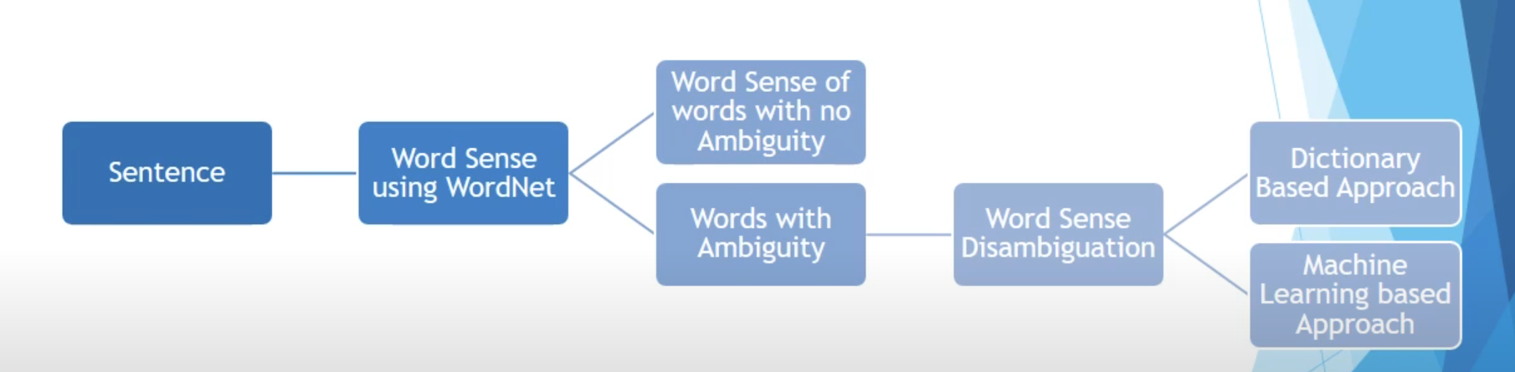
Word Sense Disambiguation

Slide 26
Evaluation of WSD
The evaluation of WSD requires the following two inputs −
A Dictionary
The very first input for evaluation of WSD is dictionary, which is used to specify the senses to be disambiguated.
Test Corpus
Another input required by WSD is the high-annotated test corpus that has the target or correct-senses. The test corpora can be of two types & minsu;
Lexical sample − This kind of corpora is used in the system, where it is required to disambiguate a small sample of words.
All-words − This kind of corpora is used in the system, where it is expected to disambiguate all the words in a piece of running text.

Slide 27
Approaches and Methods to Word Sense Disambiguation (WSD)
Dictionary-based or Knowledge-based Methods
As the name suggests, for disambiguation, these methods primarily rely on dictionaries, treasures and lexical knowledge base. They do not use corpora evidences for disambiguation.
The Lesk method is the seminal dictionary-based method introduced by Michael Lesk in 1986.
The Lesk definition, on which the Lesk algorithm is based is measure overlap between sense definitions for all words in context.
However, in 2000, Kilgarriff and Rosensweig gave the simplified Lesk definition as measure overlap between sense definitions of word and current context, which further means identify the correct sense for one word at a time.
Here the current context is the set of words in surrounding sentence or paragraph.

Slide 28
Supervised Methods
For disambiguation, machine learning methods make use of sense-annotated corpora to train. These methods assume that the context can provide enough evidence on its own to disambiguate the sense. In these methods, the words knowledge and reasoning are deemed unnecessary. The context is represented as a set of features of the words. It includes the information about the surrounding words also. Support vector machine and memory-based learning are the most successful supervised learning approaches to WSD. These methods rely on substantial amount of manually sense-tagged corpora, which is very expensive to create.

Slide 29
Semi-supervised Methods
Due to the lack of training corpus, most of the word sense disambiguation algorithms use semi-supervised learning methods. It is because semi-supervised methods use both labelled as well as unlabeled data. These methods require very small amount of annotated text and large amount of plain unannotated text. The technique that is used by semisupervised methods is bootstrapping from seed data.

Slide 30
Unsupervised Methods
These methods assume that similar senses occur in similar context. That is why the senses can be induced from text by clustering word occurrences by using some measure of similarity of the context.
This task is called word sense induction or discrimination. Unsupervised methods have great potential to overcome the knowledge acquisition bottleneck due to non-dependency on manual efforts.

Slide 31
Applications of Word Sense Disambiguation (WSD)
Machine Translation
Machine translation or MT is the most obvious application of WSD. In MT, Lexical choice for the words that have distinct translations for different senses, is done by WSD. The senses in MT are represented as words in the target language. Most of the machine translation systems do not use explicit WSD module.
Information Retrieval (IR)
Information retrieval (IR) may be defined as a software program that deals with the organization, storage, retrieval and evaluation of information from document repositories particularly textual information. The system basically assists users in finding the information they required but it does not explicitly return the answers of the questions. WSD is used to resolve the ambiguities of the queries provided to IR system. As like MT, current IR systems do not explicitly use WSD module and they rely on the concept that user would type enough context in the query to only retrieve relevant documents.
Text Mining and Information Extraction (IE)
In most of the applications, WSD is necessary to do accurate analysis of text. For example, WSD helps intelligent gathering system to do flagging of the correct words. For example, medical intelligent system might need flagging of illegal drugs rather than medical drugs
Lexicography
WSD and lexicography can work together in loop because modern lexicography is corpusbased. With lexicography, WSD provides rough empirical sense groupings as well as statistically significant contextual indicators of sense.

Slide 32
Difficulties in Word Sense Disambiguation (WSD)
Differences between dictionaries
The major problem of WSD is to decide the sense of the word because different senses can be very closely related. Even different dictionaries and thesauruses can provide different divisions of words into senses.
Different algorithms for different applications
Another problem of WSD is that completely different algorithm might be needed for different applications. For example, in machine translation, it takes the form of target word selection; and in information retrieval, a sense inventory is not required.
Inter-judge variance
Another problem of WSD is that WSD systems are generally tested by having their results on a task compared against the task of human beings. This is called the problem of interjudge variance.
Word-sense discreteness
Another difficulty in WSD is that words cannot be easily divided into discrete submeanings.
Notes:
https://web.stanford.edu/~jurafsky/slp3/slides/Chapter18.wsd.pdf

Slide 33
Lesk Algorithm
Lesk Algorithm is a classical Word Sense Disambiguation algorithm introduced by Michael E. Lesk in 1986.
The Lesk algorithm is based on the idea that words in a given region of the text will have a similar meaning. In the Simplified Lesk Algorithm, the correct meaning of each word context is found by getting the sense which overlaps the most among the given context and its dictionary meaning.

Slide 34
8. Word Sense Disambiguation (WSD)
Supervised WSD
Train a classifier on labeled data.
from nltk.wsd import lesk
sentence = "He went to the bank to deposit money".split()
sense = lesk(sentence, "bank")
print(sense, sense.definition())
c1= lesk(word_tokenize('Water current'),'current')
print(c1,c1.definition())
c1= lesk(word_tokenize('The current time is 2 AM'),'current')
print(c1,c1.definition())

Slide 35
Dictionary & Thesaurus-Based WSD
Uses lexical resources like WordNet.
Real-Life Example:
A dictionary lookup for a chatbot to select word meanings.

Slide 36
9. Dictionary and Thesaurus-Based WSD
Uses lexical resources like WordNet and thesauruses.
print(wordnet.synsets("bank")) #

Slide 37
Dictionary in NLP
Uses in NLP:
Token normalization (lemmatization/stemming)
Part-of-Speech tagging
Named Entity Recognition
Word sense disambiguation
Spell-check and autocorrect
A dictionary in NLP is a collection of words (or tokens) mapped to some kind of linguistic or semantic information.
🔹 Types of NLP Dictionaries:
Lexical Dictionaries – Provide word meanings, POS tags, lemmas, etc.
Example: WordNet, Merriam-Webster API, Oxford Dictionary API
Morphological Dictionaries – Contain root words and their inflected forms.
Used in stemming and lemmatization.
Domain-specific Dictionaries – Contain terms relevant to a particular domain (e.g., medical, legal).
Custom Dictionaries – Created for tasks like Named Entity Recognition (NER), sentiment classification, etc.

Slide 38
Thesaurus in NLP
A thesaurus is a resource that lists synonyms, antonyms, and related words for each word.
🔹 Common NLP Thesauri:
WordNet: The most widely used electronic lexical database with synonym sets (synsets).
Roget’s Thesaurus: Classical resource, less structured for computational use.
ConceptNet: Semantic network that relates words and concepts.
✅ Uses in NLP:
Query expansion in search engines
Paraphrase generation
Text summarization
Semantic similarity and clustering
Word sense disambiguation
Chatbot/Conversational AI vocabulary enhancement

Slide 39
syn,defi,example..
import nltk
from nltk.corpus import wordnet as wn
# Make sure WordNet is downloaded
nltk.download('wordnet')
# Get synonyms for "bright"
synonyms = set()
for syn in wn.synsets("bright"):
for lemma in syn.lemmas():
synonyms.add(lemma.name())
print(synonyms)
from nltk.corpus import wordnet as wn
# Get synonyms for "bright"
synonyms = set()
for syn in wn.synsets("bright"):
for lemma in syn.lemmas():
synonyms.add(lemma.name())
print("Synonyms of 'bright':", synonyms)
# Get definition and example
syn = wn.synsets("bright")[0]
print("Definition:", syn.definition())
print("Example:", syn.examples())

Slide 40
Word Similarity using Thesaurus and Distributional
methods.

Slide 41
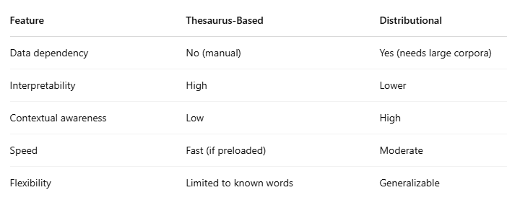
Difference between Thesaurus Based & Distributional

Slide 42
Example
import nltk
nltk.download('punkt_tab')
from nltk.wsd import lesk
from nltk.tokenize import word_tokenize
a1= lesk(word_tokenize('This device is used to jam the signal'),'jam')
print(a1,a1.definition())
a2 = lesk(word_tokenize('I am stuck in a traffic jam'),'jam')
print(a2,a2.definition())

Slide 43
Example
# testing with some data
b1= lesk(word_tokenize('Apply spices to the chicken to season it'),'season')
print(b1,b1.definition())
b2= lesk(word_tokenize('India receives a lot of rain in the rainy season'),'season')
print(b2,b2.definition())

Slide 44
These rely on structured linguistic resources like WordNet or ConceptNet.
✅ Characteristics:
Use predefined relationships like synonymy, hypernymy, antonymy, etc.
Work well even with small corpora.
Not data-driven—don't capture context-based meaning variation.
🔧 Common Thesaurus-Based Similarity Measures:
Path Similarity – Shortest path between words in the WordNet graph.
Wu-Palmer Similarity – Based on depth of the least common ancestor.
Leacock-Chodorow Similarity – Based on shortest path and depth of taxonomy.

Slide 45
Word Similarity via path & Wup
Path Similarity: 1.0
Wu-Palmer Similarity: 1.0
from nltk.corpus import wordnet as wn
word1 = wn.synsets('car')[0]
word2 = wn.synsets('automobile')[0]
# Path Similarity
print("Path Similarity:", word1.path_similarity(word2))
# Wu-Palmer Similarity
print("Wu-Palmer Similarity:", word1.wup_similarity(word2))

Slide 46
Path Similarity
Concept:
Measures similarity based on the shortest path between two concepts (synsets) in the WordNet taxonomy graph.
similarity = 1 / (path_length + 1)
Working:
Each synset is a node.
The edges represent "is-a" (hypernym/hyponym) relationships.
If the synsets are the same, path length is 0 → similarity = 1.
The more nodes between them, the lower the similarity.
from nltk.corpus import wordnet as wn
dog = wn.synset('dog.n.01')
cat = wn.synset('cat.n.01')
print(dog.path_similarity(cat)) # Output: e.g., 0.2

Slide 47
Wu-Palmer Similarity
Concept:
Measures similarity based on the depth of the least common ancestor (LCA) in the taxonomy and the depth of the individual synsets.
similarity = 2 * depth(LCS) / (depth(synset1) + depth(synset2))
Working:
Deeper LCA → More specific shared meaning → Higher similarity.
Values range from 0 (no similarity) to 1 (identical synsets).
print(dog.wup_similarity(cat))

Slide 48
Leacock-Chodorow (LCH) Similarity
Concept:
Uses the shortest path length and the maximum depth of the taxonomy to calculate similarity.
similarity = -log(path_length / (2 * max_depth))
Working:
Requires synsets to be from the same part of speech (e.g., both nouns).
Uses logarithmic scale for similarity.
Higher depth and shorter path → Higher similarity.
print(dog.lch_similarity(cat))

Slide 49
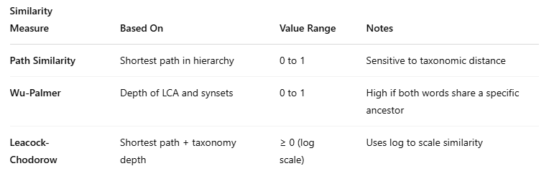
Path Similarity / Wui-Palmer / Leacock-Chodorow

Slide 50
Distributional Methods
These are based on the distributional hypothesis: "Words that occur in similar contexts tend to have similar meanings."
✅ Characteristics:
Data-driven
Captures contextual and semantic similarity
Needs large corpora
Common in modern NLP (especially with word embeddings)
🔧 Common Techniques:
Count-Based Vectors (TF-IDF, co-occurrence matrices)
Word Embeddings (Word2Vec, GloVe, FastText)
Contextual Embeddings (BERT, RoBERTa, etc.)

Slide 51
KeyedVectors
from gensim.models import KeyedVectors
# Load pretrained word2vec model (GoogleNews-vectors-negative300.bin.gz)
# This file is large (~1.5GB) and must be downloaded separately
model = KeyedVectors.load_word2vec_format('GoogleNews-vectors-negative300.bin.gz', binary=True)
similarity = model.similarity('king', 'queen')
print("Similarity between 'king' and 'queen':", similarity)
# Most similar words to "virus"
print(model.most_similar('virus', topn=5))

Slide 52
import gensim.downloader as api
model = api.load("glove-wiki-gigaword-100")
similarity = model.similarity("teacher", "instructor")
print("GloVe similarity:", similarity)

